Slide 1
19.7 DNA Sequence Alignment
Network Optimization Applications 19.7 by 成大工資管

Slide 2
Introduction
Goal:
To compare the similarity with 2 DNA sequence
Related problem:
shortest path problem
Network Optimization Applications 19.7 by 成大工資管

Slide 3
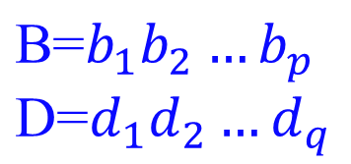
Introduction
Three operations
  cost
  Add 𝝰
  Delete β
  Change 𝐠(b,d)
Network Optimization Applications 19.7 by 成大工資管

Slide 4
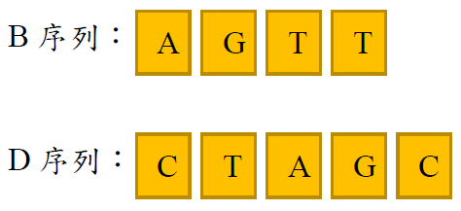
Introduction
Network Optimization Applications 19.7 by 成大工資管

Slide 5
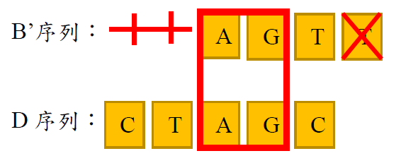


Introduction
Network Optimization Applications 19.7 by 成大工資管

Slide 6
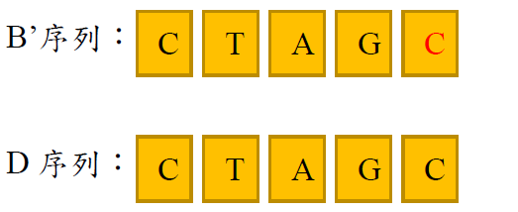

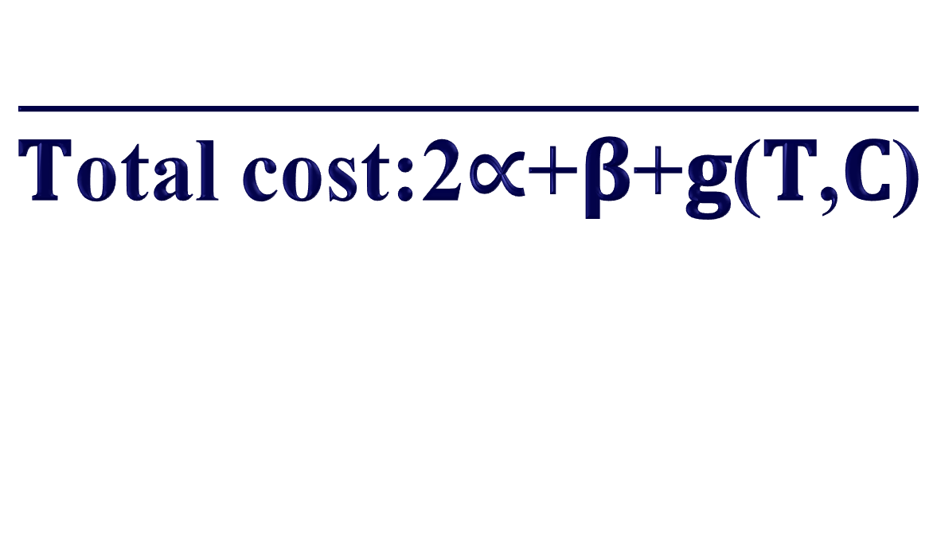
Introduction
Network Optimization Applications 19.7 by 成大工資管

Slide 7
Transform to network
Three operations
  cost
  Add 𝝰 1^{1 →} 1²
  Delete β 1^{1 →} 2¹
  Change 𝐠(b_{i},d_{j}) 1^{1→} 2²
Network Optimization Applications 19.7 by 成大工資管

Slide 8









































Transform to network
1
2
3
4
5
6
A
T
T
C
A
G
A
T
T
C
A
G
G
A
C
T
1
G
-
A
T
T
C
A
G
2
A
G
A
C
T
-
-
-
3
C
4
T
Network Optimization Applications 19.7 by 成大工資管

Slide 9

Transform to network
1
2
3
4
5
6
A
T
T
C
A
G
A
T
T
C
A
G
G
A
C
T
1
G
-
A
T
T
C
A
G
2
A
G
A
-
-
C
T
-
3
C
4
T
Network Optimization Applications 19.7 by 成大工資管

Slide 10
Reference
MICHAEL S. WATERMA. 1984. “General methods of sequence comparison.”
Network Optimization Applications 19.7 by 成大工資管

Slide 11
Thanks for Listening
Network Optimization Applications 19.7 by 成大工資管

